Slide 1
MultiObjective Vehicle Routing Problem with Time Window
Group members:-
IIT2021091 (Sanjay Vishnoi)
IIT2021093 (Ramesh Kumar)
IIT2021256 (Harsh Kumar)
Under the guidance of Dr. Gaurav Srivastava

Slide 2
Introduction
Multi Objective Vehicle Routing Problem with Time window
The MOVRP is a combinatorial optimization problem that seeks the most efficient routes for a fleet of vehicles to deliver goods to a set of locations
Why It Matters:
Widely used in logistics, e-commerce, and public transportation.
Helps in reducing costs, improving efficiency, and promoting sustainability.
Real-World Applications:
Cab Services : Improved route planning for buses and ride-sharing services.
E-commerce & Retail: Ensures fast and cost-effective delivery of goods.
Logistics & Delivery Services: Optimizes routes to minimize time and fuel consumption.

Slide 3
Problem Statement
Nature of the Problem:
MOVRP is classified as an NP-hard problem, meaning there is no efficient algorithm to find the optimal solution in polynomial time.
As the number of locations increases, complexity grows exponentially.
Key Constraints:
Vehicles start and end their routes at a central depot.
Each customer is visited exactly once by one vehicle.
Adherence to time windows for customer service.
Every vehicle has a fixed capacity.

Slide 4
Objective Functions
Two Objective Functions:
f1​: Minimize the number of vehicles used (K).
f2​: Minimize the total distance traveled (∑dij where dij​ is the distance between locations i and j).
Constraints:
Each customer is served once by one vehicle.
Vehicles start and return to the depot.
Service times are within the allocated time windows.
Vehicles have fixed capacity of C.

Slide 5
Literature Review:
S No | Title | Journal | Brief Overview
1. | The new optimization algorithm for the vehicle routing problem with time windows using multi-objective discrete learnable evolution model [1] | Soft Computing (Springer) 2020 | MODLEM Approach: Introduces a Multi-Objective Discreet Learnable Evolution Model (MODLEM) that integrates machine learning (decision trees) with evolutionary algorithms to enhance VRPTW solutions. Performance Evaluation: Tested on Solomon’s VRPTW benchmark, demonstrating superior solution quality and computational efficiency compared to state-of-the-art methods.
2. | NSGA-II with objective-specific variation operators for multiobjective vehicle routing problem with time windows [3] | Applied Soft Computing(Elsevier) 2023 | NSGA-II Based Approach: Uses NSGA-II with objective-specific variation operators for MOVRP-TW. Optimized Operators: Crossover and mutation tailored to problem characteristics and objectives. Superior Performance: Outperforms state-of-the-art methods on benchmark instances.
3. | An Evolutionary Many-Objective Optimization Algorithm Using Reference-point Based Non-dominated Sorting Approach, Part I: Solving Problems with Box Constraints[6] | IEEE journal 2014 | NSGA-III is a many-objective evolutionary algorithm that uses reference points to maintain diversity and guide selection. It outperforms previous methods like NSGA-II in high-dimensional objective spaces by ensuring a well-spread Pareto front.

Slide 6
MultiObjective Optimisation:
Involves optimizing two or more conflicting objectives simultaneously. Trade-Off in Multi-Objective Optimization
No single "best" solution → Instead, we get a Pareto Front of optimal trade-offs.
Pareto Optimality: A solution is Pareto-optimal if no objective can be improved without worsening another.
Decision Maker's Role: Choose a solution based on priority (e.g., prioritize fuel efficiency over time).

Slide 7
Approach : NSGA-II[3]
NSGA-II (Non-Dominated Sorting Genetic Algorithm II) is a powerful evolutionary algorithm designed for solving multi-objective optimization problems.
Efficient in finding diverse solutions across conflicting objectives (e.g., minimizing distance vs. vehicles used).

Slide 8
Approach : NSGA-III[6]
NSGA-III (Non-Dominated Sorting Genetic Algorithm III) is an advanced extension of NSGA-II, designed to handle many-objective optimization problems (typically with 3 or more objectives).
It introduces a reference-point-based selection mechanism to maintain a well-distributed set of solutions across the objective space. This allows NSGA-III to overcome the limitations of crowding distance in NSGA-II, making it highly effective for generating diverse and convergent solutions in complex optimization scenarios.

Slide 9
Methodology:
Steps in NSGA-II: [3]
Initial Population
Non-Dominated Sorting
Crowding Distance Calculation
Selection, Crossover, and Mutation
Population Update

Slide 10
Steps in NSGA-III:[6]
Initial Population
Non-Dominated Sorting
Reference Point Generation
Reference Point Association
Niche Preservation (Environmental Selection)
Selection, Crossover, and Mutation
Population Update

Slide 11
Results of NSGA-II with State of Art:[1]
S No
Instance | No. of customers | Optimal Results (No. of Vehicles, Total Distance) | Our NSGA II Results (No. of Vehicles, Total Distance)
1.
2.
3.
4.
R101 | 25 | 8 | 617 km | 8 | 618 km
R101 | 50 | 12 | 1044 km | 12 | 1054 km
C101 | 25 | 3 | 191 km | 3 | 184 km
C101 | 50 | 5 | 362 km | 5 | 339 km
5.
RC101 | 25 | 4 | 461 km | 4 | 454 km

Slide 12
Results of NSGA-III with State of Art:[1]
S No
Instance | No. of customers | Optimal Results (No. of Vehicles, Total Distance) | Our NSGA III Results (No. of Vehicles, Total Distance)
1.
2.
3.
4.
R101 | 25 | 8 | 617 km | 8 | 618 km
R101 | 50 | 12 | 1044 km | 12 | 1057 km
C101 | 25 | 3 | 191 km | 3 | 217 km
RC101 | 25 | 4 | 461 km | 4 | 562 km
5.
RC101 | 50 | 8 | 946 km | 8 | 945 km

Slide 13
Running Time Analysis:
S.No. | Instance | Base Paper Time (sec) | Our NSGA - II (sec) | Our NSGA -III (sec)
1 | R101 | 128.75 | 61.20 | 59.5
2 | C101 | 113.05 | 40.9 | 54.7
3 | RC101 | 117.42 | 52.1 | 54.4

Slide 14
Conclusion:
Both algorithms closely matched or improved upon the benchmark in many scenarios.
NSGA-II showed slightly better adaptability in clustered datasets (C101).
The results validate that our implementation is effective and scalable for solving

Slide 15
Future Work:
Fine-Tune Parameters: Experiment with different parameter settings (e.g., population size, crossover rate, mutation rate) to optimize performance across a wider range of problem instances.
Hybrid Approaches: Combine NSGA-II/NSGA-III with local search methods to refine solutions and enhance convergence.
Extend to Many-Objective Problems: Adapt and test the algorithm for scenarios with more than two objectives (e.g., cost, time, emissions) using NSGA-III’s reference-point-based diversity preservation mechanism.

Slide 16
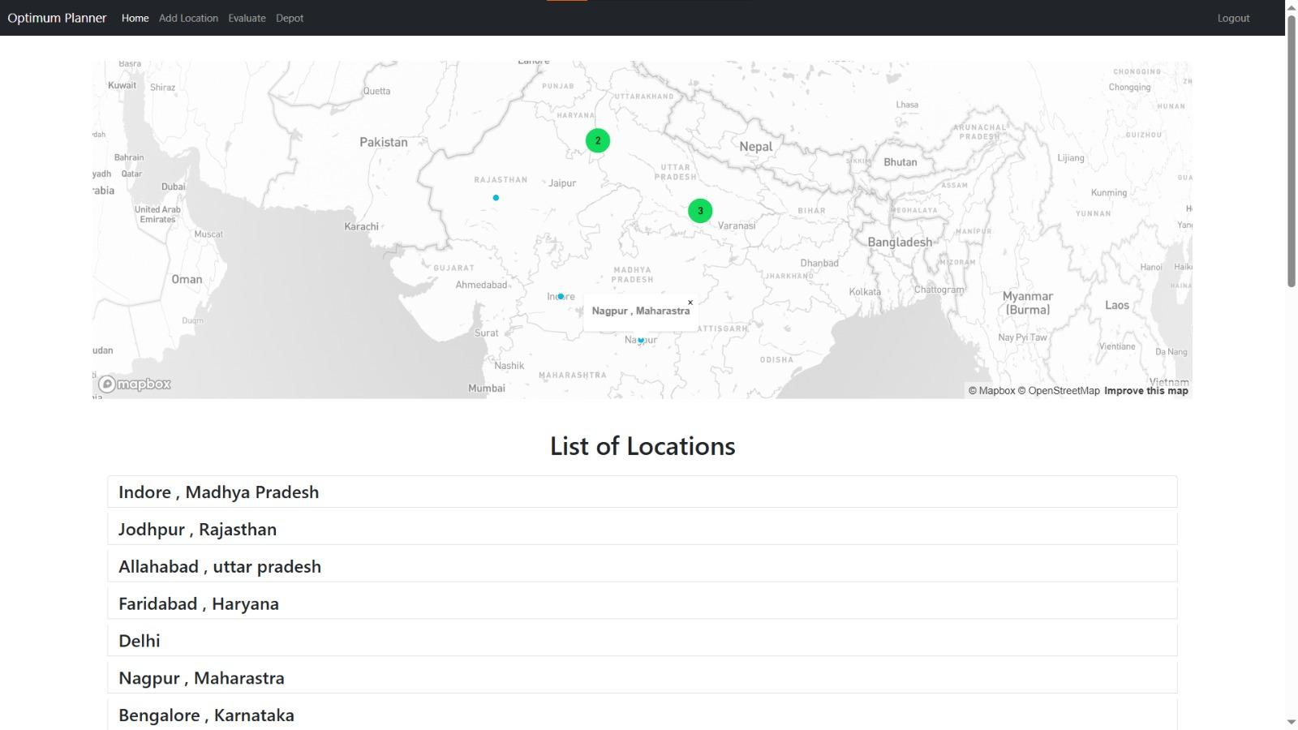

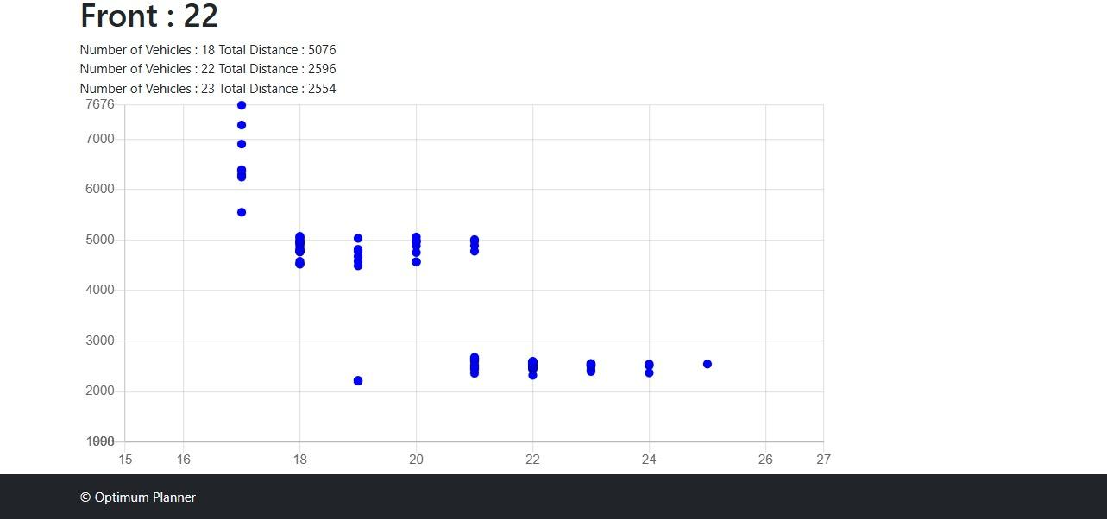
Application :

Slide 17
References:
[1] Behzad Moradi 1 , “The new optimization algorithm for the vehicle routing problem with time windows using multi-objective discrete learnable evolution model” , Soft Computing , Springer , 2020
[2] Francisco dos Santos, Lino A. Costa & Leonilde Varela ,”Performance Comparison of NSGA-II and NSGA-III on Bi-objective Job Shop Scheduling Problems”,International Conference on Optimization, Learning Algorithms and Applications ,01 February 2024
[3] Alok Singh , Rammohan Mallipeddi “ NSGA-II with objective-specific variation operators for multiobjective vehicle routing problem with time windows ” , Applied Soft Computing , Elsevier , 2023
[4] Gaurav Srivastava, Alok Singh , “Two evolutionary approaches with objective-specific variation operators for vehicle routing problem with time windows and quality of service objectives”,Expert Systems With Applications , Elsevier, 2021
[5] Yoa X,Gao Ling ,”Non-Dominated Sorting Genetic Algorithm II” ,Renewable and Sustainable Energy Review,2020
[6]Kalyanmoy Deb, Himanshu Jain, “An evolutionary many-objective optimization algorithm using reference-point based non-dominated sorting approach, Part I: Solving problems with box constraints”, IEEE Transactions on Evolutionary Computation, 2014.

Slide 18
THANK YOU !!

